Slide 1
Chapter 2
Array
Data Structure
Software College Northeastern University

Slide 2

Overview
ADT of Array
Sequence List
ADT of Polynomial
Special Array and Sparse Array
String
ArrayList
Data Structure
Software College Northeastern University

Slide 3





What is an array?
Array：
The basic mechanism for storing a collection of identically-typed objects.
√
×
Data Structure
Software College Northeastern University

Slide 4
The character of array
  it is linear structure
  Each element except the first has a unique predecessor, and each element except the last has a unique successor.
  Given the size of the element and the start address, we can know the address of any element
Data Structure
Software College Northeastern University

Slide 5

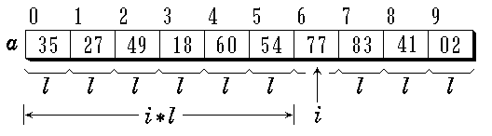
One-dimensional array
LOC ( i ) = LOC ( i -1 ) + l =α+ i*l
Data Structure
Software College Northeastern University

Slide 6

Two-dimensional array three-dimensional array
row index i page index i
column index j row index j
column index k
Data Structure
Software College Northeastern University

Slide 7
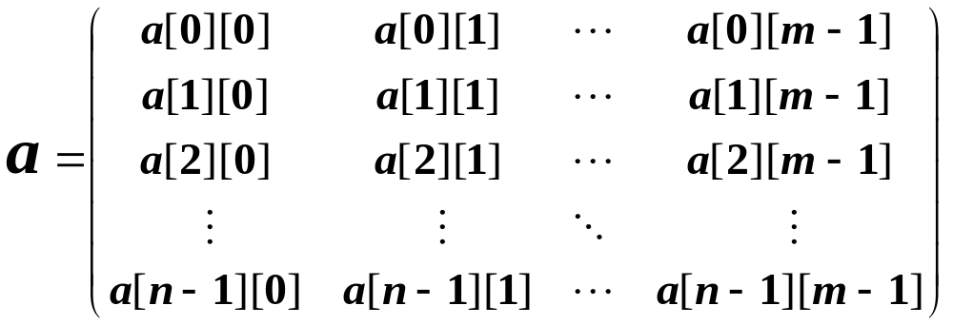
Two-dimensional array
Row major order: LOC ( i, j ) = a + ( i * m + j ) * l
Column major order:LOC ( i, j ) = a + ( j * n + i ) * l
Data Structure
Software College Northeastern University

Slide 8
Three-dimensional array
dimension values are m₁, m₂, m₃
the address of the element associated with index i, j, k
LOC ( i, j, k ) = a + ( i *m₂*m₃+j*m₃+ k )* l
Data Structure
Software College Northeastern University

Slide 9
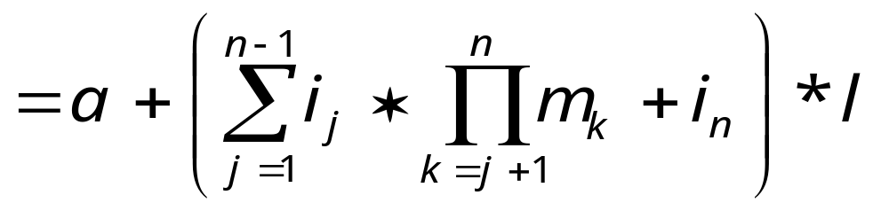
n-dimensional array
dimension values are m₁, m₂, m₃, …, m_{n}
the address of the element associated with index i₁, i₂, i₃, …, i_{n}
LOC ( i₁, i₂, …, i_{n} ) = a +
( i₁*m₂*m₃*…*m_{n} + i₂*m₃*m₄*…*m_{n}+ ……
+ i_{n-1}*m_{n} + i_{n} ) * l
Data Structure
Software College Northeastern University

Slide 10
Primitive arrays can’t satisfy us
We expect an array to know how many objects are in its collection (C and C++ don’t support)
We expect a copy of an array to copy the entire collection
We expect using an array to process dynamic data which may be altered during execution.
We expect that when allocated arrays are no longer needed, the memory that these arrays consumes is automatically reclaimed
.......
How to do ?
Data Structure
Software College Northeastern University

Slide 11
ADT of Array —— Class Declaration
public class Array<Type>{
private Type[] elements;
public int length;
public Array();
public Array(int size);
public Type get(int index);
public Type set(int index, Type newVal);
}
Data Structure
Software College Northeastern University

Slide 12
Overview
ADT of Array
Sequence List
ADT of Polynomial
Special Array and Sparse Array
String
ArrayList
Data Structure
Software College Northeastern University

Slide 13
Sequence list
Using consecutive set of memory locations (Array)
Address of element ai
Loc(ai ) = Loc( a0 )+ i × L
· Random-access storage
a0
a1
ai-1
ai
ai+1
an-1
Sequential mapping
Data Structure
Software College Northeastern University

Slide 14
Implementation:Sequence list
Sequence list ：Dynamic array
public class SeqList<Type>{
private static final int DEFAULT_CAPACITY = 10;
private Type[] elements;
private int size;
public SeqList( ){
elements = (Type[]) new Object[DEFAULT_CAPACITY];
size=0;
}
public SeqList(int sz){
elements = (Type[]) new Object[sz];
size=0;
}
Data Structure
Software College Northeastern University

Slide 15
Implementation:Sequence list
public void clear(){
size = 0;
}
public int size(){
return size;
}
public isEmpty(){
return size ==0;
}

Slide 16
Implementation:Sequence list
public Type get(int index){
if(index<0 || index>=size)
throw new ArrayIndexOutOfBoundsException();
return elements[index];
}
public Type set(int index, Type newVal){
if(index<0 || index>=size)
throw new ArrayIndexOutOfBoundsException();
Type old = elements[index];
elements[index] = newVal;
return old;
}

Slide 17
Implementation:Sequence list
public void ensureCapacity(int newSize){
if( newSize < size ) return;
Type[] old = elements;
elements = (Type[])new Object[newSize];
for(int i=0; i<size; i++)
elements[i]=old[i];
return;
}
public void trimToSize() {
ensureCapacity(size);
}

Slide 18
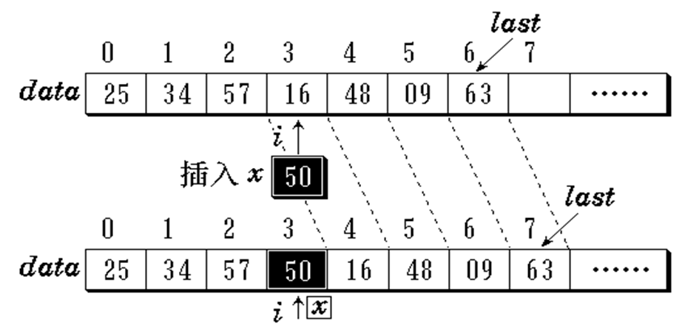
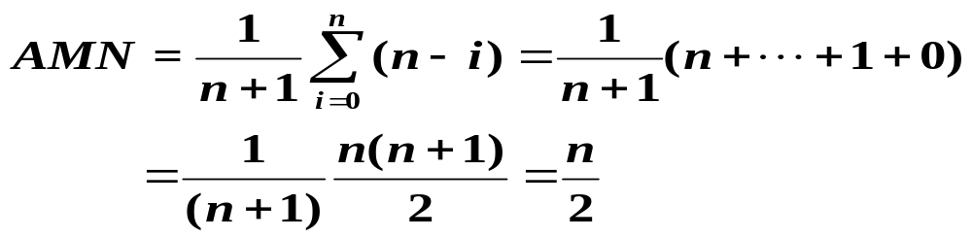
Insertion
How to move？
for ( int j = last+1; j >i; j-- )
data[j] = data[j - 1];
如何移动？
for ( int j = i; j <=last; j++)
data[j+1] = data[j ];
Data Structure
Software College Northeastern University

Slide 19
Implementation:Sequence list
public void add(int index, Type x){
if( index<0 || index>size )
throw new ArrayIndexOutOfBoundsException();
if(elements.length==size)
ensureCapacity(size*2+1);
for (int i=size; i>index; i--)
elements[i]=elements[i-1];
elements[index]=x;
size++;
}
public boolean add(Type x){
add(size, x);
return true;
}

Slide 20
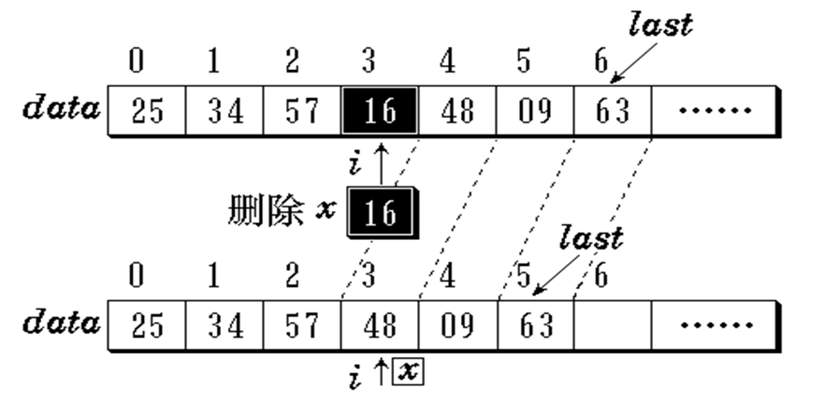
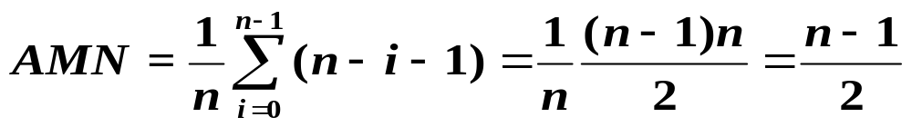
deletion
Data Structure
Software College Northeastern University

Slide 21
Implementation:Sequence list
public Type remove(int index){
Type removedEmt = elements[index];
for(int i=index;i<size-1;i++)
elements[i]=elements[i+1];
size--;
return removedEmt;
}
public boolean remove(Type x){
...
}
}

Slide 22
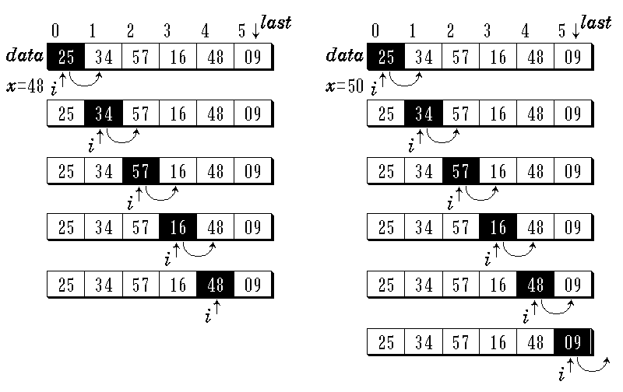
Diagram of finding
x = 48 x = 50
Data Structure
Software College Northeastern University

Slide 23
Implementation:Sequence list
public int find(Object x){
if(x==null)
for( int i=0; i<size; i++)
if( elements[i]==null) return i;
else
for( int i=0; i<size; i++)
if(x.equals(elements[i]) return i;
return -1;
}

Slide 24

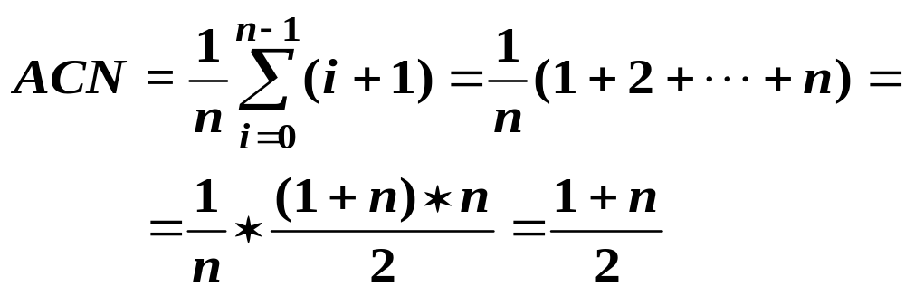
      Success:
      Average Comparing Number
      Failure: n
Data Structure
Software College Northeastern University

Slide 25
顺序表用数组实现的操作的特点
    1.通过元素的存储顺序反映线性表中
    数据元素之间的逻辑关系；
    2.可随机存取顺序表的元素；
    3.顺序表的插入、删除操作要通过移动元素实现，效率较低；
    4.元素较少时存储空间的利用率较低。
Data Structure
Software College Northeastern University

Slide 26
Application:sequence list
Example 2-1：using sequence list to resolve the union of two set A and B
A＝ A∪ B
idea：
（1）use type SeqList to store set A and B
（2）get element from B not existent in A, add them to A
A
B
Data Structure
Software College Northeastern University

Slide 27
Application:sequence list
public static<Type> SeqList<Type> union( SeqList<Type> A,
SeqList<Type> B ){
for ( int i = 0; i<B.size(); i++ ) {
Type x = B.get(i); //取B中第i个元素
int k = A.find (x); //在A中搜索它
if ( k == -1 ) //若未找到插入它
A.add(x);
}
return A;
}
Time complexity：O(A.size()*B.size())
4
3
A
B
2
1
Data Structure
Software College Northeastern University

Slide 28
Application:sequence list
Example2-2：using sequence list to compute
A=A∩B
idea：
（1）Use type SeqList to store ordered list
（2）Delete the element which isn’t in other list through comparing
A
B
Data Structure
Software College Northeastern University

Slide 29
Application:sequence list
public static<Type> SeqList<Type> Intersection ( SeqList<Type> A, SeqList<Type> B ){
int i = 0;
while ( i < A.size() ) {
Type x = A.get (i);
int k = B.find (x);
if ( k == -1 ) //B中没有该元素，则在A中删除
A.remove (x);
else //B中有该元素，则处理A中下一元素
i++;
}
return A;
}
Data Structure
Software College Northeastern University

Slide 30
Overview
ADT of Array
Sequence List
ADT of Polynomial
Special Array and Sparse Array
String
ArrayList
Data Structure
Software College Northeastern University

Slide 31
ADT of Polynomial
P(x) = p₀ + p₁ x + p₂ x² + … + p_{n} x^{n}
Q(x) = q₀ + q₁ x + q₂ x²+ … + q_{m} x^{m}
Addition of two polynomials ,suppose m<n R(x)=(p₀+q₀)+(p₁+q₁)x+…+(p_{n}+q_{m})x^{m}+p_{m+1} x^{m+1} + … +p_{n} x^{n}
P = (p₀, p₁, p₂ , …p_{n})
Q = (q₀, q₁, q₂, …q_{m})
R = (p₀+q₀, p₁+q₁, …, p_{m}+q_{m}, p_{m+1,} …, p_{n} )
Data Structure
Software College Northeastern University

Slide 32
Polynomial ADT
public class Polynomial {
public Polynomial ( );
public float coef ( int e);
//return coefficient of the item with e exponent
public int leadExp ( ); //return the max exponent
public Polynomial add (Polynomial poly);
public Polynomial multiply (Polynomial poly);
public float eval ( float x);
}
Data Structure
Software College Northeastern University

Slide 33
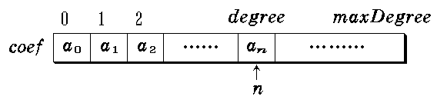
Physical representation
First ：
private int degree;
private float[] coef ;
public Polynomial (int leadExp) {
  degree = leadExp;
  coef = new float [degree+1];
  }
Pn(x) ：
pl.degree = n
pl.coef[i] = ai, 0 ≤ i ≤ n
Data Structure
Software College Northeastern University

Slide 34
Second：
private int degree;
private SeqList<float> coef;
Pn(x)：
pl.degree = coef.size()-1;
pl.coef.get(i) = ai, 0 ≤ i ≤ n
Data Structure
Software College Northeastern University

Slide 35
Some polynomial only have few nonzero coefficents ：
P₁₀₁(x) = 3 + 5x⁵⁰ - 14x¹⁰¹
pl.degree = 101
pl.coef = new float[102]
Method：
Only store the nonzero item
3 | 0 | 0 | …… | 5 | …… | 14
0 | 1 | 2 |  | 50 |  | 101
Data Structure
Software College Northeastern University

Slide 36
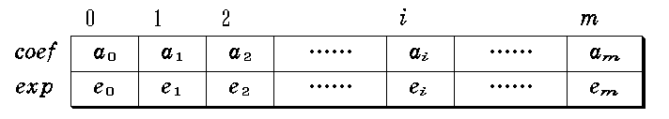
Third：
class Term { //多项式中非零项的定义
float coef; //系数
int exp; //指数
}
public class Polynomial{
private OrderedSeqList<Term> terms;
...
terms:
Data Structure
Software College Northeastern University

Slide 37
Third：
public Term getTerm(int i){
return terms.get(i);
}
public void setTerm(Term t) {
terms.set(t);
}
public void addTerm(Term t){
terms.add(t);
}
public void removeTerm(Term t){
terms.remove(t);
}
public int size(){ return terms.size(); }

Slide 38
Add two polynomials
A(x) = 2.0x¹⁰⁰⁰+1.8
B(x) = 1.2 + 51.3x⁵⁰ + 3.7x¹⁰¹
结果多项式另存
扫描两个相加多项式，若都未检测完：
  若当前被检测项指数相等，系数相加。
  若未变成 0，则将结果加到结果多项式。
  若当前被检测项指数不等，将指数小者加到结果多项式。
若有一个多项式已检测完，将另一个多项式剩余部分复制到结果多项式。
Data Structure
Software College Northeastern University

Slide 39
public Polynomial add(Polymomial B){
Polynomial C=new Polynomial(); // C为结果多项式
int a=0; // a为this多项式的当前项索引
int b=0; // b为多项式B的当前项索引
float coef; //结果多项式当前项系数
while(a<size() && b<B.size()) {
Term ta = getTerm(a);
Term tb = B.getTerm(b);
if(ta.exp == tb.exp) {
coef = ta.coef + tb.coef;
if(coef != 0)
C.addTerm(new Term(coef, ta.exp));
a++;
b++;
}
Data Structure
Software College Northeastern University

Slide 40
if(ta.exp > tb.exp) {
C.addTerm(new Term(tb.coef, tb.exp));
b++;
}
if(ta.exp < tb.exp) {
C.addTerm(new Term(ta.coef, ta.exp));
a++;
}
}
Data Structure
Software College Northeastern University

Slide 41
for( ; a<size(); a++)
C.addTerm(new Term(getTerm(a));
for( ; b<B.size(); b++)
C.addTerm(new Term(B.getTerm(b));
return C;
}
Data Structure
Software College Northeastern University

Slide 42
Overview
ADT of Array
Sequence List
ADT of Polynomial
Special Array and Sparse Array
String
ArrayList
Data Structure
Software College Northeastern University

Slide 43
Types of Matrix
Triangle matrix
-upper triangle matrix
-lower triangle matrix
Diagonal matrix
Symmetric matrix
-It is symmetric to it’s main counter-diagonal
Sparse matrix
Data Structure
Software College Northeastern University

Slide 44
Special Matrix
Triangle matrix
-lower triangle matrix
-upper triangle matrix
a₀₀ 0 0 … 0
a₁₀ a₁₁ 0 … 0
a_{n-10}a_{n-11} a_{n-1n-1}
a₀₀ a₀₁ a_{0n-1}
0 a₁₁ a_{1n-1}
0 0 0 a_{n-1n-1}
Data Structure
Software College Northeastern University

Slide 45
Special Matrix
Symmetric matrix
-It is symmetric to it’s main counter-diagonal
a₀₀
a₁₀ a₁₁
a₂₀ a₂₁ a₂₂
a_{n-10} a_{n-11} a_{n-1n-1}
a₀₀ a₁₀ a_{n-10}
a₁₀ a₁₁ a_{n-11}
a_{n-10} a_{n-11} a_{n-1n-1}
Data Structure
Software College Northeastern University

Slide 46
Special Matrix
a₀₀
a₁₀ a₁₁
a₂₀ a₂₁ a₂₂
a_{n-10} a_{n-11} a_{n-1n-1}
We can store a Symmetric matrix with compressed way
a₀₀ a₁₀ a₁₁ a₂₀ a₂₁ a₂₂ a_{n-10} a_{n-11} a_{n-1n-1}
k= 0 1 2 3 4 5 6 n(n+1)/2-1
Store the lower triangle only
Required a space: n(n+1)/2
Data Structure
Software College Northeastern University

Slide 47
Special Matrix
i(i+1)/2 +j when i ≥ j
j(j+1)/2 +i when i < j
k =
a₀₀ a₁₀ a₁₁ a₂₀ a₂₁ a₂₂ a_{n－10} a_{n－11} a_{n－1n－1}
k= 0 1 2 3 4 5 6 n(n+1)/2-1
For example：address of element a₄₂ in one-dimensional array sa[ ] ：
k=4*(4+1)/2+2=12
sa[12]= a₄₂
Data Structure
Software College Northeastern University

Slide 48
d
a₀₀ a₀₁ a ₀₂ 0 0 0 0 0 0 0 0 0
a₁₀ a₁₁ a₁₂ a₁₃ 0 0 0 0 0 0 0 0
a₂₀ a₂₁ a₂₂ a₂₃ a₂₄ 0 0 0 0 0 0 0
0 a₃₁ a₃₂ a₃₃ a₃₄ a₃₅ 0 0 0 0 0 0
0 0 a₄₂ a₄₃ a₄₃ a₄₅ a₄₆ 0 0 0 0 0
0 0 0 a₅₃ a₅₄ a₅₅ a₅₆ a₅₇ 0 0 0 0
0 0 0 0 a₆₄ a₆₅ a₆₆ a₆₇ a₆₈ 0 0 0
0 0 0 0 0 a₇₅ a₇₆ a₇₇ a₇₈ a₇₉ 0 0
0 0 0 0 0 0 a₈₆ a₈₇ a₈₈ a₈₉ a₈₁₀ 0
0 0 0 0 0 0 0 a₉₇ a₉₈ a₉₉ a₉₁₀ a₉₁₁
0 0 0 0 0 0 0 0 a₁₀₈ a₁₀₉ a₁₀₁₀ a₁₀₁₁
0 0 0 0 0 0 0 0 0 a₁₁₉ a₁₁₁₀ a₁₁₁₁
Diagonal matrix
d: width of half band
The number non-zero elements:
(2d+1)*n-(1+d)*d
Data Structure
Software College Northeastern University

Slide 49
Special Matrix
a ₀₀ a₀₁ 0 0 0
a₁₀ a₁₁ a₁₂ 0 0
0 a₂₁ a₂₂ a₂₃ 0
0 0 a₃₂ a₃₃ a₃₄
0 0 0 a₄₃ a₄₄
The number of non-zero elements per row:
n(2d+1)
The address of a_{ij}
in compressed array :
k=i*(2d+1)+d+(j-i)
How do we calculate the address of the diagonal matrix that d=2,n=6?
example：d=1
？
K= 0 1 2 3 4 5 6 7 8 9 10 11 12 13 14
0 a₀₀ a₀₁ a₁₀ a₁₁ a₁₂ a₂₁ a₂₂ a₂₃ a₃₂ a₃₃ a₃₄ a₄₃ a₄₄ 0
Data Structure
Software College Northeastern University

Slide 50
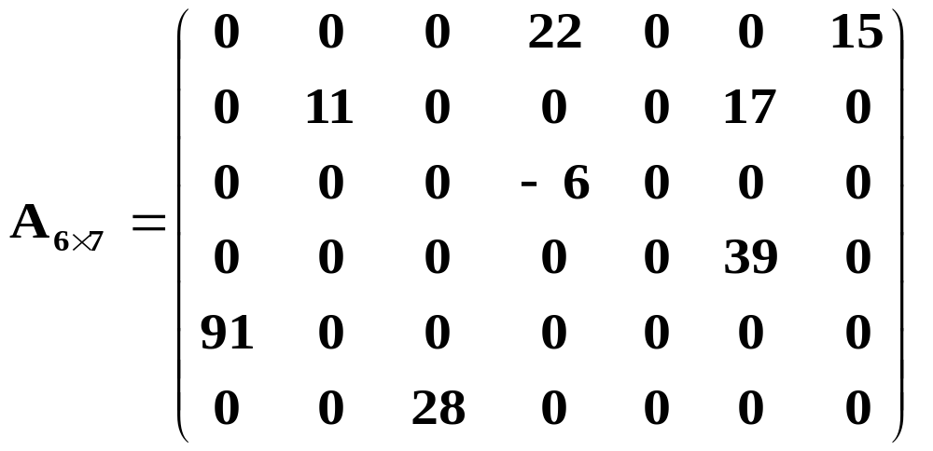
Sparse Matrix
A matrix is sparse if it has only a small number of non-zeros.
8/6*7 = 8/42
Data Structure
Software College Northeastern University

Slide 51
Sparse Matrix
Sparse Matrices in real applications are usually huge. Much space can be saved if we only store non-zeros.
  Space cost for all matrix entries = O(m*n)
  Space cost for non-zeros entries = O(t)
Problem : if only non-zeros are stored, we also need to store their location in a matrix. So a good representation is required.
Data Structure
Software College Northeastern University

Slide 52
Sparse Matrix
Some variables are defined in Sparse Matrix Type:
  Height – number of rows
  Width - number of columns
Tri-vector Type to store non-zeros entries and their locations.
<row, column, value>
Data Structure
Software College Northeastern University

Slide 53
Structure Sparse_Matrix is objects: a set of triples, <row, column, value>, where row and column are integers and form a unique combination, and value comes from the set item. functions: for all a, b ∈ Sparse_Matrix, x  item, i, j, max_col, max_row  index
Sparse Matrix
Data Structure
Software College Northeastern University

Slide 54
Sparse_Marix Create(max_row, max_col) ; return a Sparse_matrix that can hold up to max_items = max _row  max_col and whose maximum row size is max_row and whose maximum column size is max_col.
Sparse_Matrix Transpose(a); return the matrix produced by interchanging the row and column value of every triple.
Sparse_Matrix Add(a, b); if the dimensions of a and b are the same return the matrix produced by adding corresponding items, namely those with identical row and column values. else return error
Sparse Matrix
Data Structure
Software College Northeastern University

Slide 55
Sparse_Matrix Multiply(a, b) ; if number of columns in a equals number of rows in b return the matrix d produced by multiplying a by b according to the formula: d [i] [j] =
(a[i][k]•b[k][j]) where d (i, j) is the (i,j)th element else return error.
Sparse Matrix
Data Structure
Software College Northeastern University

Slide 56
Sparse Matrix
row col value
0
1
2
3
4
5
6
7
8
0 1 12
0 12 9 0 0 0 0
0 0 0 0 0 0 0
-3 0 0 0 0 14 0
0 0 24 0 0 0 0
0 18 0 0 0 0 0
15 0 0 -7 0 0 0
0 2 9
2 0 -3
2 5 14
A =
3 2 24
4 1 18
5 0 15
5 3 -7
Data Structure
Software College Northeastern University

Slide 57
class Term{ public int col; public int row; public int value;
} public class SparseMatrix{ private int rows; private int cols; private int terms; private Term[] elements;
...
}
Sparse Matrix
Data Structure
Software College Northeastern University

Slide 58
Sparse Matrix
6
7
8
A.rows
A.cols
A.terms
A.elem
0 12 9 0 0 0 0
0 0 0 0 0 0 0
-3 0 0 0 0 14 0
0 0 24 0 0 0 0
0 18 0 0 0 0 0
15 0 0 -7 0 0 0
A =
row col value
0
1
2
3
4
5
6
7
8
0 1 12
0 2 9
2 0 -3
2 5 14
3 2 24
4 1 18
5 0 15
5 3 -7
Data Structure
Software College Northeastern University

Slide 59
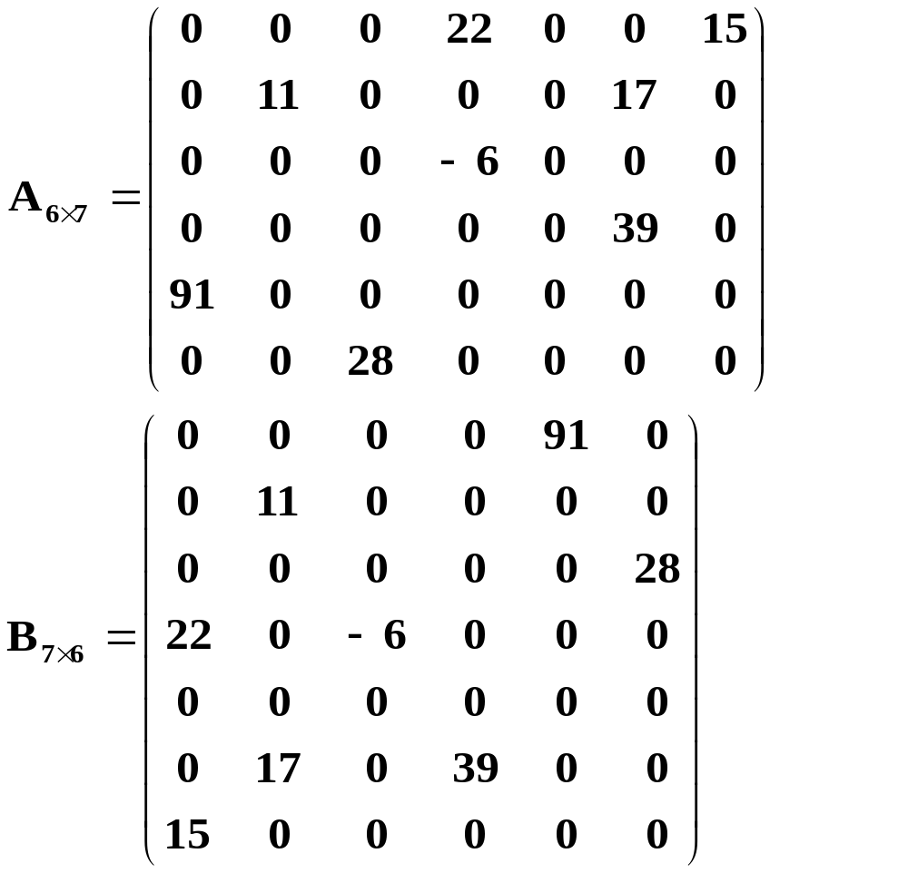
Sparse Matrix
Sparse
matrix
transpose matrix
Data Structure
Software College Northeastern University

Slide 60
Sparse Matrix
public static int[][] transpose(int matrix[][]){
int a[][] = new int[matrix[0].length][matrix.length];
for(int i = 0;i < matrix[0].length;i++){
for(int j = 0;j < matrix.length;j++){
a[i][j] = matrix[j][i];
}
}
return a;
}
How do we transpose compressed matrix?
How do we transpose compressed matrix?
Data Structure
Software College Northeastern University

Slide 61
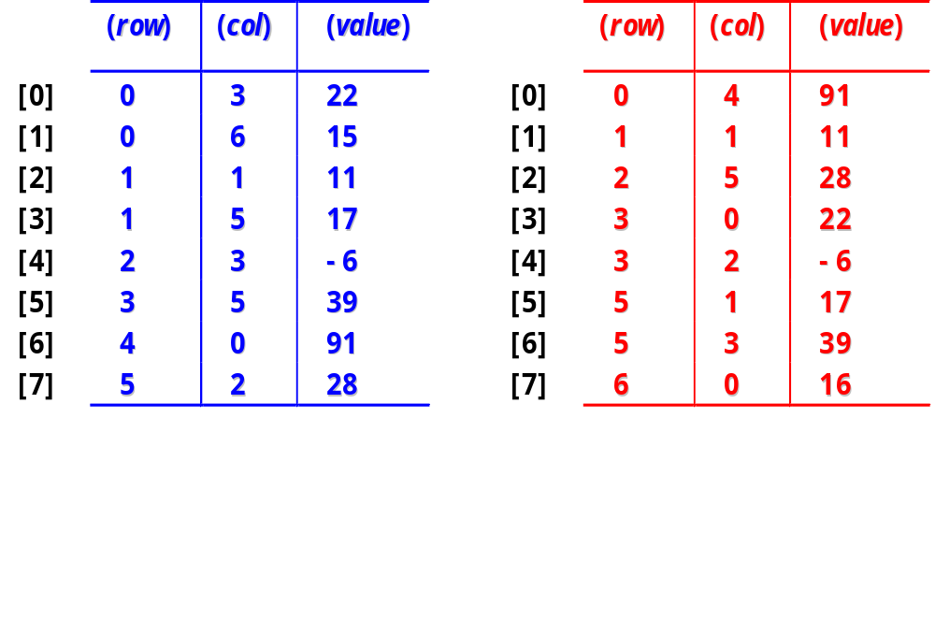
Sparse Matrix
Data Structure
Software College Northeastern University

Slide 62
Sparse Matrix
public SparseMatrix Transpose( ) {
SparseMatrix b = new SparseMatrix();
b.rows = cols;
b.cols = rows;
b.terms = terms;
if(b.terms > 0) {
int currentPos = 0;
for(int r=0; r<b.rows; r++) //select rth row
for( int i=0; i<terms; i++)
Data Structure
Software College Northeastern University

Slide 63
Sparse Matrix
if(elem[i].col == r) {
b.elem[currentPos].row = r;
b.elem[currentPos].col = elem[i].row;
b.elem[currentPos].value = elem[i].value;
currentPos++;
}
}
return b;
}
Space complexity: O(1) time complexity :O(terms*cols)
O(m*n²)
Data Structure
Software College Northeastern University

Slide 64
Sparse Matrix
Data Structure
Software College Northeastern University

Slide 65
Sparse Matrix
Fast-transpose Solution:
  -Determine the number of elements in each column of the original matrix.
  -Determine the starting positions of each row in the transpose matrix.
Create two array to store the number of elements and starting positions of each row in transposed matrix
Scan a.term array, determine the position of a element stored in b. term according to its column and rowStart
Time complexity : O(max(Terms, Cols))
Space complexity :O(Cols)
Data Structure
Software College Northeastern University

Slide 66
Sparse Matrix
public SparseMatrix Transpose( ) {
SparseMatrix b = new SparseMatrix();
b->rows = cols;
b->cols = rows;
b->terms = terms;
int[]rowSize = new int[b.rows];
int[] rowStart = new int[b.rows];
for(int i=0; i<b.rows; i++) rowSize[i] = 0;
for(int i=0; i<terms; i++)
rowSize[elem[i].col] ++;
Data Structure
Software College Northeastern University

Slide 67
Sparse Matrix
rowStart[0] = 0;
for(int i=1; i<b.rows; i++)
rowStart[i] = rowStart[i-1] + rowSize[i-1];
int p, q;
for(int i=0; i<terms; i++){
q = elem[i].col;
p = rowStart[q];
b.elem[p].row = elem[i].col;
b.elem[p].col = elem[i].row;
b.elem[p].value = elem[i].value;
rowStart[q]++;
}
return b;
}
Data Structure
Software College Northeastern University

Slide 68
Overview
ADT of Array
Sequence List
ADT of Polynomial
Special Array and Sparse Array
String
ArrayList
Data Structure
Software College Northeastern University

Slide 69
String as ADT
Strings are a special case of lists
They are treated separately because the basic operations on strings are different from those of lists
Although we usually think of strings of characters we could deal with strings of arbitrary elements but, in computing, the major application of strings is in strings of characters
Data Structure
Software College Northeastern University

Slide 70
String as ADT:Defination
The characters of a string can be identified by their position
So, a string S consists of the characters: S[0], S[1], …, S[n-1]
A contiguous subset of the characters of S is called a substring of S
  I.e., if 0 < i < j < n-1 then S[i], S[i+1], …, S[j] is a substring of S
The empty string contains no characters
S₀
S₁
S₂
...
S_{n-1}
Data Structure
Software College Northeastern University

Slide 71
String as ADT:Defination
Example:
c = “DATA STRUCTURE” ，f= “DATA”
S1=“abcdefg”, S2=“bcde”, S3 =“afg”, S4=“DATA”
String f is a substring of string c.
S2 is a substring of S1. S3 is not a substring of S1.
The position of string f occurs in string c is 1.
String f is equal to string S4.
The length of S3 is 3.
Data Structure
Software College Northeastern University

Slide 72
String as ADT: basic operations
ADT String
｛Object：D={ai| ai∈ CharacterSet, i=1,2,...,n,n>=0}
Relationship：R1＝{<ai-1,ai>| ai-1,ai ∈ D,i=2,...,n}
basic operations：
strAssign(chars)
condition：chars is constant string
result：construct this string equal to chars
strCopy(S)
condition：String S is existent
result：copy the value of string S to this String
Data Structure
Software College Northeastern University

Slide 73
String as ADT: basic operations
isEmpty()
condition：this String is existent
result：if this string is empty，return true，else return false
strCompare(T)
condition：this string and String T are both existent
result：if this string>string T, return value >0,if this=T return 0，else this<T, return value <0
strLength()
condition： this String is existent
result：return the number of chars in this string
Data Structure
Software College Northeastern University

Slide 74
String as ADT: basic operations
clearString()
condition：this String is existent
result：clear this String to empty string
concat(S1，S2)
condition：string S1 and String s2 are both existent
result： joins two strings S1 and S2 together to this String
subString(S, pos, len)
condition：String S is existent, 0< pos ≤strLength(S)
and 0≤ len ≤strLength(S)-pos+1
result：returns part of a string S from pos to pos_len-1 with this string
Data Structure
Software College Northeastern University

Slide 75
String as ADT: basic operations
index(T, pos)
condition：this String and T are both existent, and the position is 1≤ pos ≤strLength(S)
result： returns the position at which string T occurs within this String after position pos
replace (T,V)
condition：this String and T are both existent, and String T is not empty string
result：replace the occurrence of string T with string V in this string
Data Structure
Software College Northeastern University

Slide 76
Growing a string: three approaches
Create a new third string which is the aggregate size of the other two strings and copy the characters across
  Expensive for large strings
Create a string buffer in memory and use just part of the string initially, using more of the buffer later on
  E.g. Null character indicates end of used part of the buffer
Create a linked list of chunks of string, rather than an array
  Truly unbounded, but overhead involved with maintaining list
Data Structure
Software College Northeastern University

Slide 77
String as ADT: Implementations
public int indexOf(String str){
//return the position at which string str occurs within this string
int k;
for(k=0 ; k<length()-t.length(); k++){
String substr = substring(k,k+t.length());
if(substr.compareTo(t)==0 break; //if they are equal
}
if (k<length()-t.length())
return k+1;
else return 0;
}
Data Structure
Software College Northeastern University

Slide 78
“Pattern matching”:another name for find
In pattern matching, we want to find the position of some pattern in a text string
This has many frequently-used applications in computing, and efficient algorithms are important
pattern: ABCABCACAB length: 10
text: BABCBABCABCAABCABCABCACABC length: 26
A simple algorithm is to start at the left, comparing single characters from the pattern and the text
If a pair of characters mismatch, then shift the pattern one place to the right, and restart matching from the start of the pattern
Data Structure
Software College Northeastern University

Slide 79
Simple algorithm: example
BABCBABCABCAABCABCABCACABC
A#########
ABCA######
A#########
A#########
A#########
ABCABCAC##
A#########
A#########
ABCAB#####
A#########
A#########
AB########
ABCABCAC##
A#########
A#########
ABCABCACAB
The first line is the text
Subsequent lines are attempts to match the pattern to the text
If a character of the pattern does not match the text, the pattern shifts one character to the right, and we try again
# represents uncompared characters in the pattern
pattern
text
Data Structure
Software College Northeastern University

Slide 80
Simple algorithm: pseudocode
while (!matched && !exhausted)
//未发现匹配成功，并且未到末尾
{
while (pattern char == text char)
advance to next char of text and pattern;
if(pattern char != text char){
//如果发现一对不相等
shift pattern one character right;
start search at left end of pattern;
}
else matched = TRUE;
}
Data Structure
Software College Northeastern University

Slide 81
Simple algorithm: analysis
In the worst case, the algorithm’s performance is
t x p (where t is text length, p is pattern length)
pattern: AAAAA...AB length: p
text: AAAAAAAAAA...AB length: t
The example on the previous slide requires 47 character comparisons to find the match at position 16
Is there a quicker algorithm?
Data Structure
Software College Northeastern University

Slide 82
Simple algorithm:a naïve improvement
Rather than shift the pattern to the right by one character, we could shift by the length of the pattern
However, in doing this we could miss some matches!
text: ABABACAC
ABAC
pattern: ABAC
ABAC
Shift 4 characters, and miss a match!
Two better algorithms were discovered in the 1970s:
Knuth-Morris-Pratt
Boyer-Moore
Data Structure
Software College Northeastern University

Slide 83
Knuth-Morris-Pratt algorithm (KMP)
When a mismatch is found:
  the pattern is moved as far as possible to the right, based on information already known about the pattern
  this information is calculated before matching begins, in the preprocessing stage
  the search then continues from the same place in the text as where the mismatch occurred
Data Structure
Software College Northeastern University

Slide 84
KMP algorithm: example
This time, the pattern shifts right by varying amounts (not always by 1)
BABCBABCABCAABCABCABCACABC
ABCABCACAB
ABCABCACAB
ABCABCACAB
ABCABCACAB
ABCABCACAB
ABCABCACAB
pattern
text
Data Structure
Software College Northeastern University

Slide 85
KMP algorithm: preprocessing
In the pre-processing stage, KMP calculates an offset for each character in the pattern
If a mismatch occurs at a character c, the number of characters to shift the pattern right is given by c’s offset
Examples of patterns with their calculated offsets:
The actual method of calculating the offsets is somewhat involved
ABCABCACA APPLE PREPARED
112445739 11234 11243567
Data Structure
Software College Northeastern University

Slide 86
KMP algorithm: using the offsets (example)
D’s offset is 3, so when a mismatch occurs on D, the pattern is moved to the right and to compare the first R with current char in text.
Similarly for the other characters.
REAL RED READING
READ
READ
READ
READ
READ
READ
READ
Pre-processing
READ
1 1 2 3
Data Structure
Software College Northeastern University

Slide 87
KMP algorithm: pseudocode
while (!matched && !exhausted)
{
while (pattern char == text char)
advance to next char of text and pattern;
if(pattern char != text char){
shift pattern as far right as possible;
// Amount to shift pattern to the right is obtained from a
// table which is calculated by pre-processing the pattern
if pattern has been moved past the current position of the text
start search one position to the right;
else
start search at current position of the text;
}
else matched = TRUE;
}
Data Structure
Software College Northeastern University

Slide 88
String
java.lang.String
The String class represents character strings. All string literals in Java programs, such as "abc", are implemented as instances of this class.
Beyond the basic support of initialization, concatenation, length, class string provides a set of higher-level string handling functions
Data Structure
Software College Northeastern University

Slide 89
Overview
ADT of Array
Sequence List
ADT of Polynomial
Special Array and Sparse Array
String
ArrayList
Data Structure
Software College Northeastern University

Slide 90
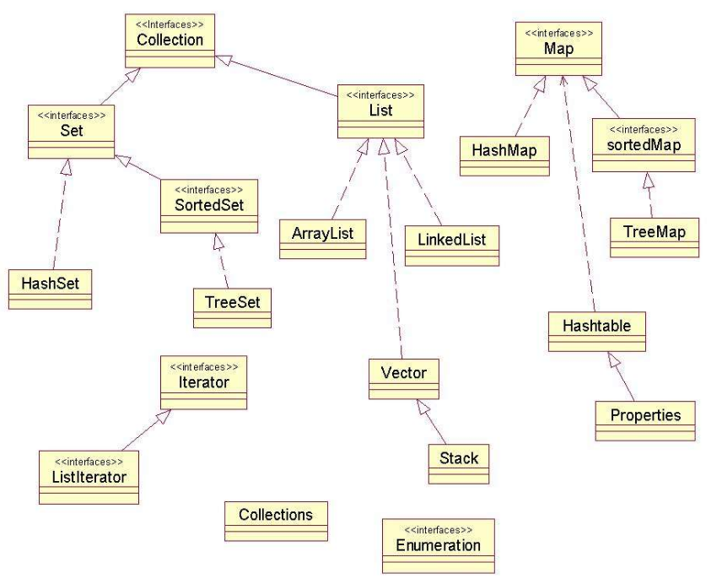
Data Structure
Software College Northeastern University

Slide 91
Interface Collection<E>
add(E e)
Ensures that this collection contains the specified element
contains(Object o)
Returns true if this collection contains the specified element.
equals(Object o)
Compares the specified object with this collection for equality.
remove(Object o)
Removes a single instance of the specified element from this collection, if it is present (optional operation).
toArray()
Returns an array containing all of the elements in this collection.
iterator()
Returns an iterator over the elements in this collection.
Data Structure
Software College Northeastern University

Slide 92
Interface List<E>
public interface List<E> extends Collection<E>
An ordered collection (also known as a sequence). The user of this interface has precise control over where in the list each element is inserted. The user can access elements by their integer index (position in the list), and search for elements in the list.
indexOf(Object o) //Returns the index of the first occurrence of the specified element in this list, or -1 if this list does not contain the element.
Data Structure
Software College Northeastern University

Slide 93
Class ArrayList<E>
Resizable-array implementation of the List interface. Implements all optional list operations, and permits all elements, including null.
In addition to implementing the List interface, this class provides methods to manipulate the size of the array that is used internally to store the list.
ensureCapacity(int minCapacity) //Increases the capacity of this ArrayList instance, if necessary, to ensure that it can hold at least the number of elements specified by the minimum capacity argument.
trimToSize() //Trims the capacity of this ArrayList instance to be the list's current size.
Data Structure
Software College Northeastern University

Slide 94
Class ArrayList<E>
import java.util.*;
public static void main(String[] args) {
ArrayList<String>list = new ArrayList<String>();
list.add("Collection");
list.add("List");
list.add("ArrayList");
for(int i=0; i<list.size(); i++)
System.out.println(list.get(i));
list.remove(1);
for(String str: list)
System.out.println(str);
}
Data Structure
Software College Northeastern University

